Slide 1
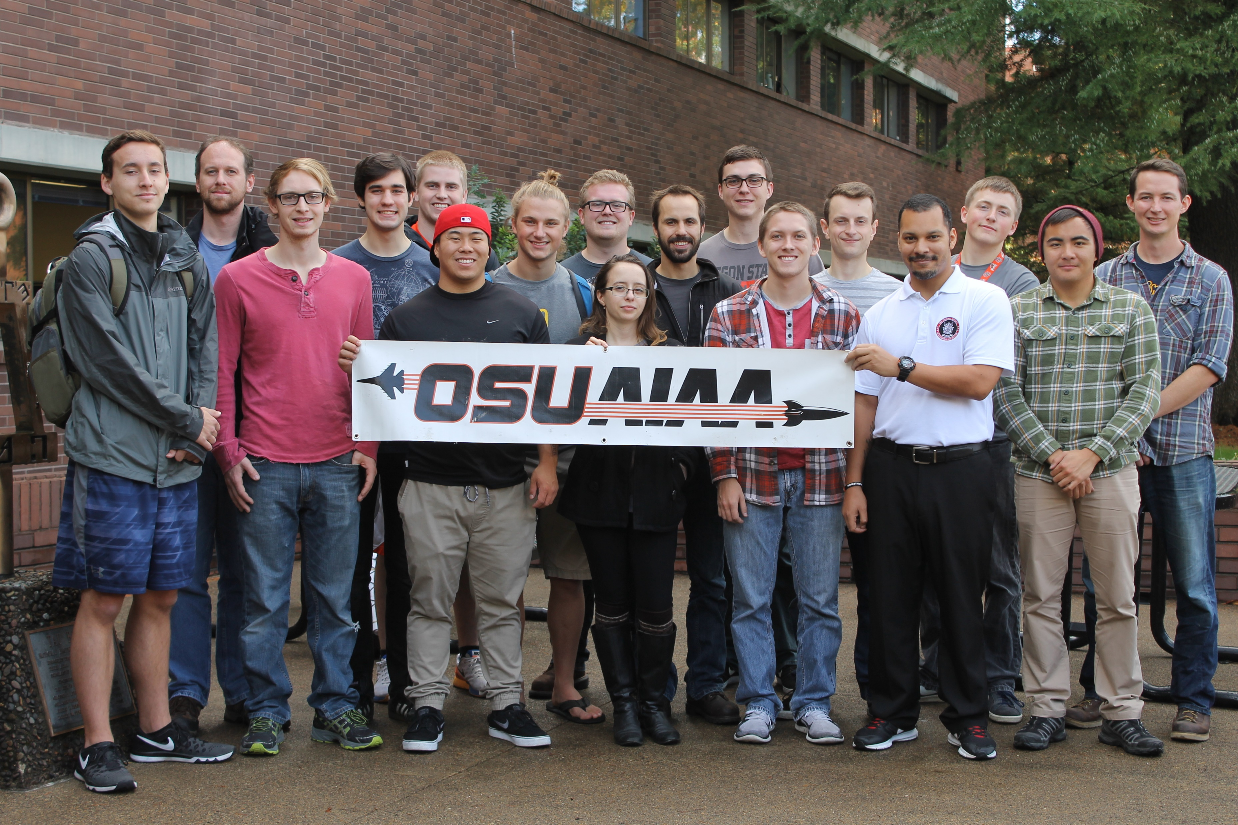
Fall Progress Report
Team #25
Natasha Anisimova, Terrance Lee, Albert Morgan

Slide 2

Introduction: The Problem
Launch a rocket in the Black Rock Desert
Receive telemetry and visualize in real-time
Aid in recovery
Track rocket
Log telemetry for later retrieval
Create a usable user interface

Slide 3
Our Clients
High-Altitude Rocketry Team
Led by Dr. Nancy Squires
Clients are engineering students
Software team given a lot of flexibility

Slide 4
Architecture
Client
Web Server
Client
New Packet
Client
Logger
Other processes

Slide 5
Built-in Node Web Server
Easier to install
Easier to run
Easier to develop

Slide 6
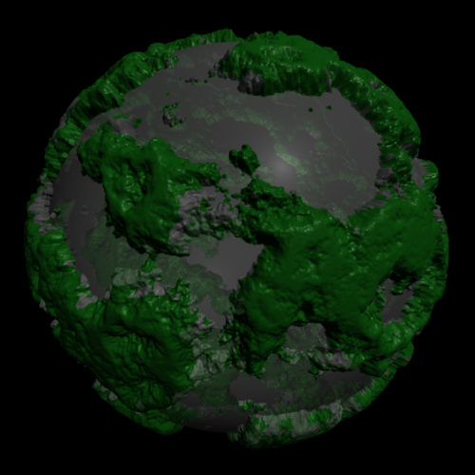
Frontend and Web Browser
Tables updating in Real-Time
3.js
WebGL canvas
Displacement mapping
GPS only turns on at apogee

Slide 7
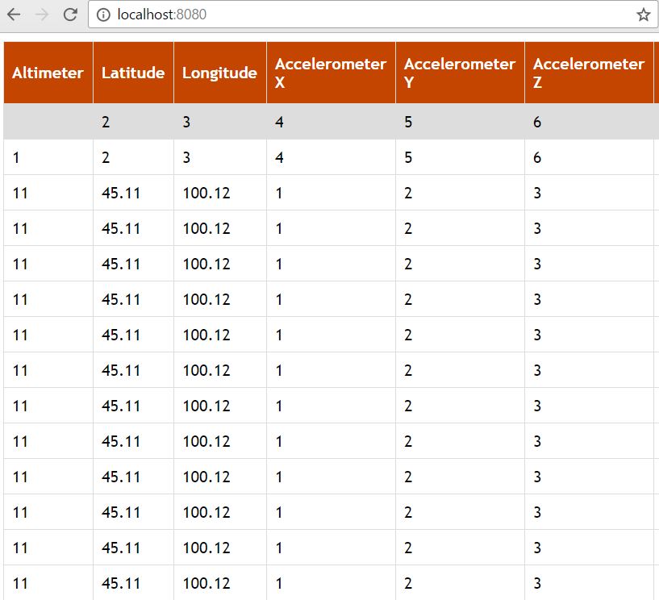
User Interface
Numerical Data
Data Visualization
Height Map for Spaceport America
Mike Bailey
Scale aspect ratio
Web dependencies

Slide 8
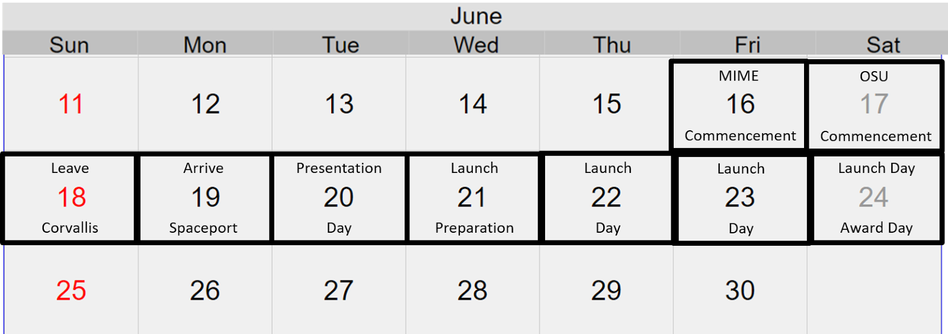
Retrospective of the past 6 weeks
Working with OSU AIAA Chapter Team (High-Altitude Rocketry Team)
Setup Communication Protocol
Revision of Documents
Launch Travel Plans
Issues
Branching
GPS turning on at apogee

Slide 9
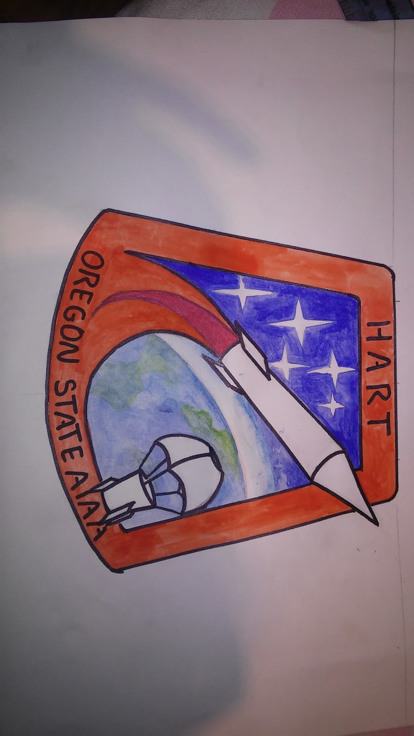
Plans
Create correctly scaled 3D environment
Testing suite
Telemetry Protocol
Avionics Team
Further Revision of Documents
OneNote
Design Document
Get data from launch
Test flight in March

